Slide 1


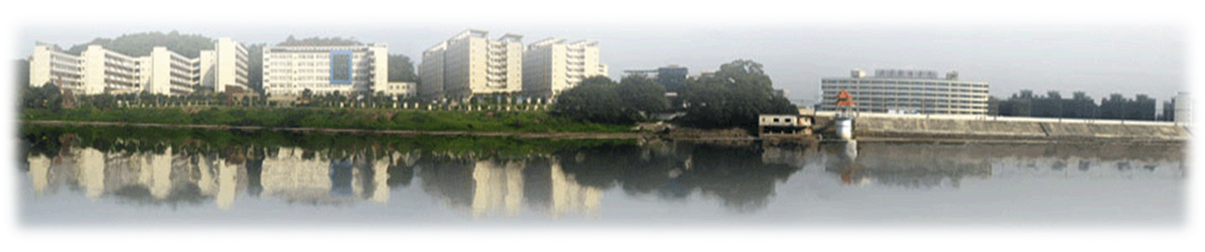
《嵌入式系统设计与应用》说课
《Distributed Big Data Technology》
International Education College
Meng Ren
Notes:
https://www.renrendoc.com/paper/111762807.html
https://www.renrendoc.com/paper/111762807.html
课题：哈夫曼编码译码器系统
问题描述打开一篇英文文章，统计该文章中每个字符出现的次数，然后以他们作为全职对每个字符进行编码，编码完成后再对其编码进行译码
CDIO代表构思（Conceive）、设计（Design）、实现（Implement）和运作（Operate） ，它以产品研发到产品运行的生命周期为载体 ,让学生以主动的、 实践的、 课程之间有机联系的方式学习工程。CDIO培养大纲将工程毕业生的能力分为工程基础知识、 个人能力、 人际团队能力和工程系统能力四个层面，大纲要求以综合的培养方式使学生在这四个层面达到预定目标。

Slide 2
Distributed Big Data Technologies
Accessing data in HDFS

Slide 3
Hadoop deployment
Hadoop supports three deployment modes(textbook 3.3)：
Standalone
Pseudo-distributed
Distributed

Slide 4
Hadoop deployment
Standalone：
Default mode
Running on a single machine, without a distributed file system
Hardly anyone uses this mode
Notes:
Default mode of Hadoop. Running on a single machine, without a distributed file system, instead directly reading and writing to the local operating system's file system. Hardly anyone uses this mode.

Slide 5
Hadoop deployment
Pseudo-distributed：
Runs on a single machine, but with a distributed file system
The single machine simulates multiple hosts to complete jobs in a distributed manner
Used for quick testing to simulate the effects of distribution
Notes:
It runs on a single machine, but this mode simulates multiple hosts to complete Hadoop jobs in a distributed manner.
It uses a distributed file system with only one node, and job tasks are assigned to multiple independent Java processes for processing.
It is mainly used for quick testing to simulate the effects of distribution.

Slide 6
Hadoop deployment
Distributed Mode：
It requires multiple machines to implement a cluster system. In this case, a distributed file system with multiple nodes will be used, and tasks will be assigned to multiple machines for processing.
This deployment pattern is generally used in production environments.
Using a distributed file system (HDFS) to improve storage performance and data redundancy capabilities.

Slide 7
File systems in Big Data Platform
What is File system？
A file system is a method of organizing files on storage devices, responsible for managing and storing file information through software. In other words, it is responsible for creating files for users, storing, reading, modifying, and backing up files, controlling file access, and deleting files when no longer needed by the user.
Notes:
A file system is a method of organizing files on storage devices, responsible for managing and storing file information through software. In other words, it is responsible for creating files for users, storing, reading, modifying, and backing up files, controlling file access, and deleting files when no longer needed by the user.

Slide 8
File systems in Big Data Platform
Understanding HDFS
HDFS is the foundation of data storage management in distributed computing.
It was developed to meet the needs of accessing and processing extremely large files based on a streaming data pattern.
It can run on inexpensive commercial servers and has features such as high fault tolerance, high reliability, high scalability, high availability, and high throughput.

Slide 9
The Advantages and Disadvantages of HDFS
Advantages：
High Fault Tolerance
（1）Data is automatically saved in multiple copies, with 3 copies for each block. By increasing the number of copies, fault tolerance is improved;
（2）If one copy is lost, it can be automatically recovered.
Batch Processing
Large amounts of data Processing
（1）handle data size reaching GB、TB、or even PB levels； （2）handle millions of files
Streaming file access
Built on inexpensive machines
Notes:
https://blog.csdn.net/qq_44868502/article/details/102833445?utm_medium=distribute.pc_aggpage_search_result.none-task-blog-2~aggregatepage~first_rank_ecpm_v1~rank_v31_ecpm-17-102833445.pc_agg_new_rank&utm_term=%E6%98%AFhdfs+client%E6%A8%A1%E5%BC%8F&spm=1000.2123.3001.4430
15 ，hdfs 理论知识 ( 流式数据访问 )
https://blog.csdn.net/qq_34319644/article/details/92795545?utm_term=hdfs%E6%B5%81%E5%BC%8F%E8%AF%BB%E5%86%99%E6%98%AF%E4%BB%80%E4%B9%88%E6%84%8F%E6%80%9D&utm_medium=distribute.pc_aggpage_search_result.none-task-blog-2~all~sobaiduweb~default-1-92795545&spm=3001.4430

Slide 10
The Advantages and Disadvantages of HDFS
Disadvantages：
1）not suitable for low-latency data access.
2）not efficient for storing a large number of small files。
（1）If storing a large number of small files, it will consume a large amount of NameNode memory to store file, directory, and block information. This is not advisable because NameNode memory is always limited;
(2) The addressing time for storing small files will exceed the reading time.
3）does not support concurrent writing and random modification
Notes:
https://blog.csdn.net/qq_44868502/article/details/102833445?utm_medium=distribute.pc_aggpage_search_result.none-task-blog-2~aggregatepage~first_rank_ecpm_v1~rank_v31_ecpm-17-102833445.pc_agg_new_rank&utm_term=%E6%98%AFhdfs+client%E6%A8%A1%E5%BC%8F&spm=1000.2123.3001.4430
It is not suitable for low-latency data access, such as storing data in milliseconds, which is not achievable. 2) It is not efficient for storing a large number of small files. (1) If storing a large number of small files, it will consume a large amount of NameNode memory to store file, directory, and block information. This is not advisable because NameNode memory is always limited; (2) The addressing time for storing small files will exceed the reading time. 3) It does not support concurrent writing and random modification of files. (1) Only one write operation is allowed for a file, multiple threads writing simultaneously are not allowed; (2) It only supports data append, not supporting random modification of files.

Slide 11
Analyzing the principles of HDFS
Architecture and Data Storage Principles of HDFS
Master/Slave Architecture HDFS cluster consists of one Master and multiple Slaves
The NameNode on the Master manages the metadata of the file system
The DataNode on the Slave stores the actual data Clients access the file system by interacting with both the Master and the Slaves
Clients contact the NameNode on the Master to obtain the metadata of the files, while the actual file I/O operations are directly carried out with the DataNode on the Slave.

Slide 12
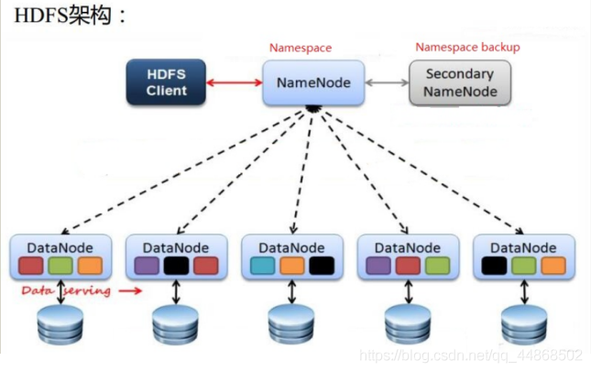
HDFS four commponts：
1、HDFS Client
2、NameNode
3、DataNode
4、Secondary NameNode。
Notes:
https://blog.csdn.net/qq_44868502/article/details/102833445?utm_medium=distribute.pc_aggpage_search_result.none-task-blog-2~aggregatepage~first_rank_ecpm_v1~rank_v31_ecpm-17-102833445.pc_agg_new_rank&utm_term=%E6%98%AFhdfs+client%E6%A8%A1%E5%BC%8F&spm=1000.2123.3001.4430

Slide 13
HDFS master services
HDFS consists of a set of Master services：
NameNode, Secondary NameNode
DataNode
Client
Notes:
https://blog.csdn.net/weixin_44018540/article/details/107176592
HDFS写入读取原理详解

Slide 14
Methods of Accessing Data
HDFS-shell, linux-shell
JAVA-API, python-API, Scala-API

Slide 15
Linux-shell
In Linux, "Shell" refers to a program that serves as an interface between the user and the Linux kernel, allowing users to interact with the operating system through the command line. The most common Shell program is Bash (Bourne Again SHell), typically located at /bin/bash, which is the primary way for users to interact with the operating system.
Notes:
Linux提供了像MicrosoftWindows那样的可视的命令输入界面--X Window的图形用户界面（GUI）。它提供了很多桌面环境系统，其操作就像Windows一样，有窗口、图标和菜单，所有的管理都是通过鼠标控制。GNOME。
每个Linux系统的用户可以拥有他自己的用户界面或Shell，用以满足他们自己专门的Shell需要。
同Linux本身一样，Shell也有多种不同的版本。主要有下列版本的Shell： Bourne Shell：是贝尔实验室开发的。
BASH：是GNU的Bourne Again Shell，是GNU操作系统上默认的shell。
Korn Shell：是对Bourne SHell的发展，在大部分内容上与Bourne Shell兼容。
C Shell：是SUN公司Shell的BSD版本。
Z Shell：The last shell you’ll ever need! Z是最后一个字母，也就是终极Shell。它集成了bash、ksh的重要特性，同时又增加了自己独有的特性。
BASH”是“Bourne- Again SHell”的缩写，意思是“伯恩-又是壳牌

Slide 16
Commonly used HDFS Shell commands
Hadoop supports many Shell commands, such as hadoop fs, hadoop dfs, and hdfs dfs, which are the most commonly used Shell commands for HDFS. They are used to view the directory structure of the HDFS file system, upload and download data, create files, etc.
Login to Linux，open a terminal．First run Hadoop with the following commands：
$ start-dfs.sh #start hdfs stop-dfs.sh
start-yarn.sh #start yarn stop-yarn.sh
Notes:
4.1 HDFS 操作常用Shell 命令
Hadoop 支持很多Sh ell 命令、例如hadoop fs 、hadoop dfs 和hdfs dfs 都是HDFS 最常
用的Shell 命令，分别用来查看HDFS 文件系统的目录结构、上传和下载数据、创建文件等。
这3 个命令既有联系有又区别。
CJ) hadoop fs: 适用于任何不同的文件系统，例如本地文件系统和HDFS 文件系统。
(2) hadoop df s : 只能适用于l-IDFS 文件系统。
(3) hdfs dfs: 跟hadoop dfs 命令的作用一样，也只能适用千HDFS 文件系统。
在本书中，统一使用hdfs dfs 命令对HDFS 进行操作。
4. 1. I 查看命令使用方法
登录Linux 系统，打开一个终端．首先启动Hadoop, 命令如下：
$cd /usr / local/hadoop
$ . /sbin/start-dfs.sh

Slide 17
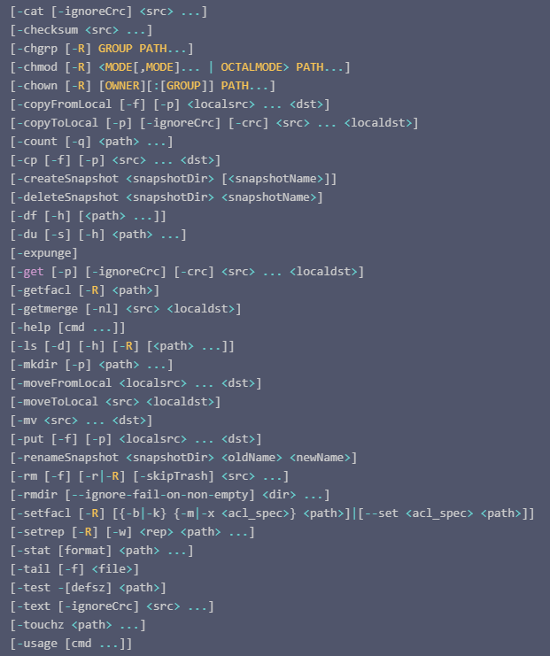
HDFS
Shell manual page
Notes:
https://cloud.tencent.com/developer/article/1586799
HDFS的Shell操作命令大全（开发重点）
Hadoop3.0.3 HDFS 常用shell 命令
https://blog.csdn.net/zhouzhiwengang/article/details/103231324

Slide 18
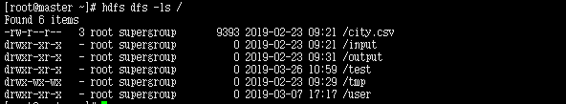
Data operation with HDFS-SHELL
help
Display
-help function：output the guidance example：hadoop fs -help
-ls function：list the files and directories in the current directory. Example: hdfs dfs -ls / list the files and directories in the current directory. hdfs dfs -ls -R /list the files in the current directory. With the -R parameter, it will also execute the ls operation in folders and subfolders.

Slide 19
Data operation with HDFS-SHELL
create folder
Copy a file from a local system to HDFS
-mkdir function：create a directory on HDFS example：hdfs dfs -mkdir -p /test/input/
-copyFromLocal or -put function：Cut and paste from local to HDFS. example：hdfs dfs -copyFromLocal /root/city.csv /test/input

Slide 20
Data operation with HDFS-SHELL
Retrieve the file from HDFS to local
View the contents of the HDFS file
-copyToLocal or -get Function: Cut and paste from HDFS to local machine. Example：hdfs dfs -copyToLocal /test/input/ city.csv /root/a.csv
-cat Function: View a file on HDFS Example: hdfs dfs -cat /test/input/city.csv -tail Function: Display the end of a file Example: hdfs dfs -tail /test/input/city.csv -text Function: Print the contents of a file in character form Example: hdfs dfs -text /test/input/city.csv

Slide 21
Data operation with HDFS-SHELL
Delete file
Delete folder
-rm -f Function: Delete a file stored in HDFS Example: hdfs dfs -rm -f /test/input/city.csv
-rm -r Function: Delete a folder in HDFS. Example：hdfs dfs -rm -r /test/input/

Slide 22
Data operation with HDFS-SHELL
copy
-cp Function: Copy a path from one location in HDFS to another location in HDFS Example: hdfs dfs -cp /test/input/city.csv /input/city.csv

Slide 23
Data operation with HDFS-SHELL
System information
-df Function: Display file system space information Example: hdfs dfs -df -h / -du Function: Display folder size information Example: hdfs dfs -du -s -h /test -count Function: Count the number of file nodes in a specified directory Example: hdfs dfs -count /

Slide 24
Data operation with JAVA-API or others
Accessing HDFS file system using FileSystem
Checking if a file or directory exists
Creating an HDFS directory
Deleting an HDFS directory
Listing the names of files or directories in a directory
Upload file
Download file
Delete file
Display
Notes:
hadoop常见操作以及简单的Hadoop javaAPI实现
https://blog.csdn.net/qq_36419130/article/details/84348773
IDEA与eclipse哪个更适合Java初学者
https://www.zhihu.com/question/379857038
在代码提示方面，VS Code可能会超过Intellij IDEA。看我的回答，
关于IDEA、Eclipse、VS Code，看我的相关回答和文章：
Hadoop +API之idea+maven搭建HDFS开发环境_Java架构师联盟
https://blog.csdn.net/weixin_42864905/article/details/104394228
大数据-09-Intellij idea 开发java程序操作HDFS(示例代码)
https://www.136.la/java/show-52459.html

Slide 25
Referance
http://dblab.xmu.edu.cn/blog/290-2/
Notes:
centOS安装hadoop、编写wordCount小程序
https://blog.csdn.net/weixin_34284188/article/details/89610302?utm_medium=distribute.pc_aggpage_search_result.none-task-blog-2~aggregatepage~first_rank_ecpm_v1~rank_v31_ecpm-8-89610302.pc_agg_new_rank&utm_term=centos7+hadoop+%E5%AE%89%E8%A3%85idea&spm=1000.2123.3001.4430
VMWare虚拟机安装CentOS 7 Linux及Hadoop与Eclipse学习环境（3-Eclipse开发环境）
https://blog.csdn.net/xiaoyw71/article/details/53316390

